Slide 1
SAP Gateway
Day II Agenda
What is NW GATEWAY and it’s advantages ?
What is Odata Protocol and its architecture in terms of WWW.
What is REST Architecture?
Metadata and Queries of OData
How to play with OData URI’s?
Entity, Entity set, relation and navigation.
Why OData?
Prerequisites which needs to be checked in Gateway System?

Slide 2
SAP Gateway
Day I Agenda
No more SAP Net weaver Gateway, It is SAP Gateway
Introduction about SAP Gateway
SAP Gateway Overview and Architecture
SAP Gateway Versions

Slide 3
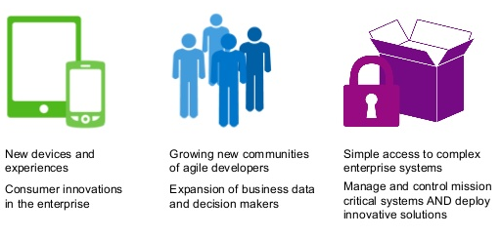
SAP Gateway
What is SAP Gateway?
Any Environment, Any Device, by Any Developer
SAP Gateway lets you empower users with secure, personalized solutions that leverage and extend your existing SAP infrastructure, all with security, robustness, agility, and efficiency. SAP Gateway lets you meet the changing needs of your business at the speed of business by enabling People agility, System agility and Process agility.

Slide 4
Capabilities of SAP Gateway
Open - Any Device, Any Experience, Any Platform
People - Optimized for User Interaction Scenarios
Timeless - Non disruptive, any SAP Business Suite version
Developers - Simple APIs, no SAP knowledge, any tool
Standards - Based on REST, ATOM/OData
Opening the doors for millions of developers to create solutions connecting to SAP
Increase workforce productivity
Reduces Complexity , skill set requirements and deployment barriers
Shorten development times/cycles
Engage all developers with their choice of development tools
It offers connectivity to SAP applications using any programming language

Slide 5
Benefits of SAP Gateway
Hides the technical complexities of your SAP system landscape behind a single interface that is easy-to-use and non-proprietary.
Makes your SAP business data and functionality accessible to any external device.
Communicate using the HTTP(S) protocol.
Understand OData messages.
Provides Service Provisioning tools that allow the quick REST-enablement of existing ABAP functionality.
Provides plug-ins for well known IDEs such as Eclipse, Visual Studio 2010 and XCode.

Slide 6
Focusing area of SAP Gateway
Any external business application. E.G. Microsoft Office applications via a .Net (or even VBA) interface
Desktop machines using Web-based applications running PHP or Java or Ruby, etc.
Native applications on mobile devices E.G. iPad/iPhone or an Android device or a Blackberry.
Embedded devices such as manufacturing robots or route planning software in Satellite Navigation systems.
Any other business scenario you can think of involving some programmable device that can speak HTTP(S).
The SAP Gateway interface can be used to supply the SAP Business Data to any programmable device that can speak HTTP(S).

Slide 7
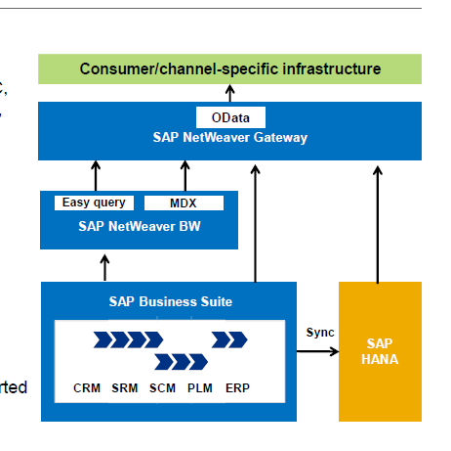
Service enablement
Generation of service based on RFC,
BAPI, BOR, BOL, MDX, SAP HANA,
OData, ABAP, and so on
Supporting the development of new
Services
Core functionalities
Error logging, serialization, traces
Pushing of back-end events
Front-end development support
(on SCN)
Generation of proxy classes and started
apps for iOS, Android, PHP, Java
Code snippets

Slide 8
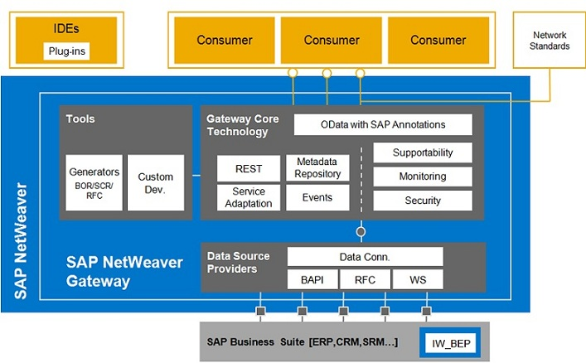
SAP Gateway Architecture

Slide 9
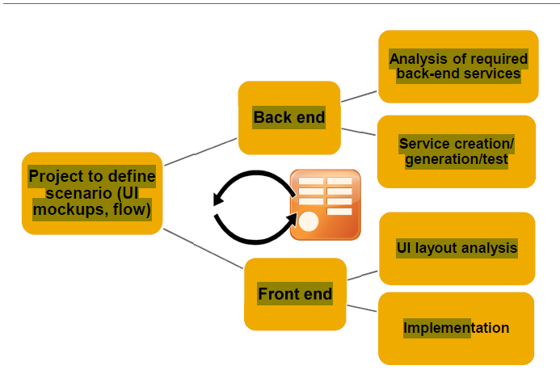
Introduction to SAP NetWeaver Gateway From Conceptual Model to a Mobile App

Slide 10
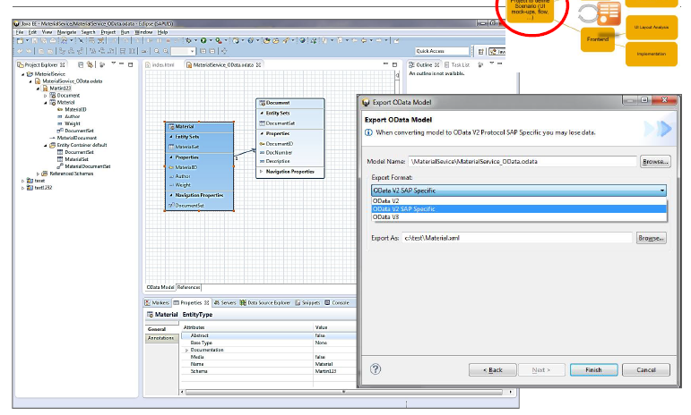

Slide 11
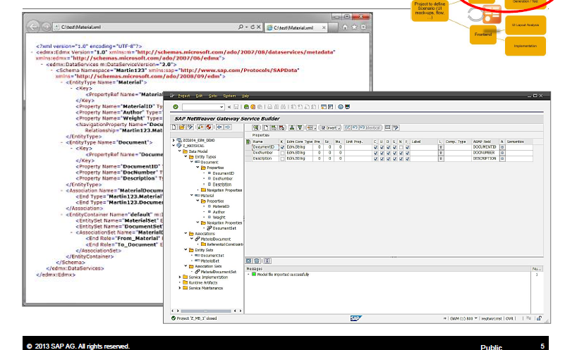

Slide 12
Deployment Options:
HUB Architecture:
Gateway server functionalities are only used on one dedicated server, the hub system. The services are deployed on the backend systems and are registered on the server. The Gateway service is thus deployed in the Gateway backend systems where either IW_BEP is deployed systems or that are running on top of 7.40 leveraging the core component SAP_GWFND.
Embedded Architecture:
In this case the services are registered as well as published in the SAP Business Suite backend system.

Slide 13
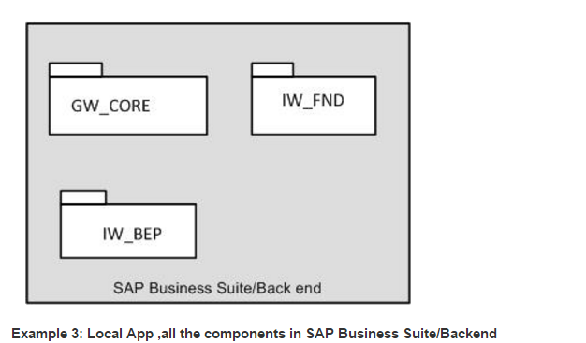
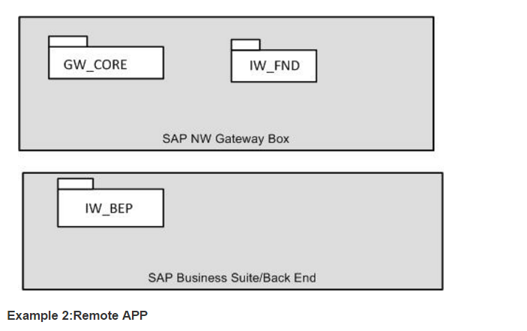
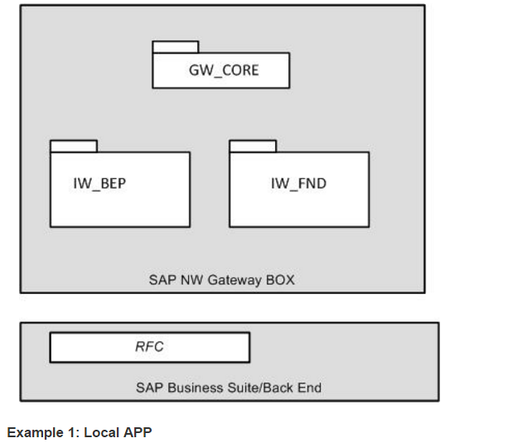

Slide 14
Versions
SAP Netweaver Gateway 1.0
SAP Netweaver Gateway 2.0
SP01
SP02
SP03
SP04
SP05
SP06
SP07
SP08
SP09( Latest)
From SP4, SAP has newly introduced Gateway Service Builder Tool, We will discuss in Day II ..

Slide 15
Questions And Answers
What does REST stands for?
Representational State Transfer
Which architecture SAP recommends?
SAP recommends Central HUB architecture as a first option, and again it depends upon the client landscape, which one to implement.
How is SAP Gateway different from Web services?
Web services are based on SOAP services and SAP Gateway is REST-based. SAP Gateway focuses on consumption scenarios and SOAP is more process-to-process and machine-to-machine.
Security Level in SAP Gateway?
SAP Gateway supports
- Browser Based SAML 2.0 Authentication.
- x.509 Client Certificate authentication
- SAP Logon tickets(SSL)
- Basic Authentication
SAP Net weaver Gateway Vs SAP Gateway
Only the calling name has been changed, and the architecture remains the same.

Slide 16
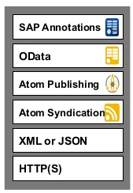
What is Open Data Protocol
OData is Microsoft developed extension to the Atom Publishing and Atom syndication Standards, which in turn are based on XML and HTTP(S).
It is Standardized protocol, built over existing HTTP and REST protocols supporting CRUD(Create, Read, GetSET, Update and Delete) operations.
We can call it as ODBC Web.
It can be used freely without the need for a license or contract.
It uses ATOM+XML or JSON.
REST-based architecture.

Slide 17
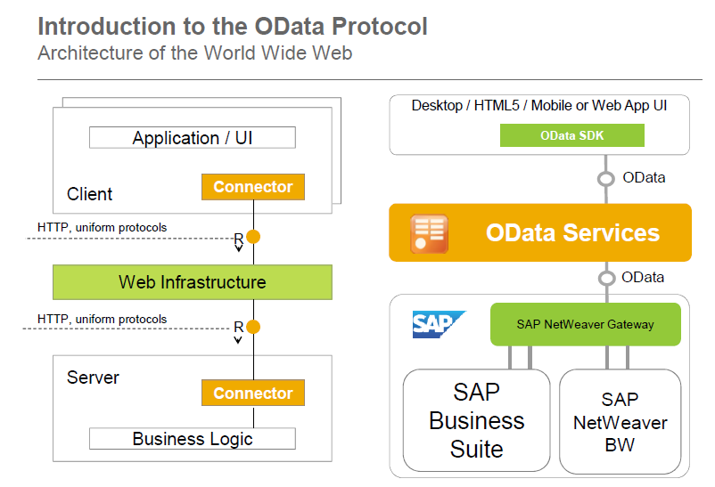
O data Protocol :WWW Architecture

Slide 18
REST Architecture
REST is an architectural framework and methodology which is based on addressability, statelessness, connectedness and uniform interface.
OData is an implementation of REST.
HTTP(S) – An Implementation of the REST constraints:
HTTP(S) is the protocol that drives the World Wide Web
A Server-side resource can be manipulated in four basic ways.
These four basic REST operations have given rise the acronym CRUD.
REST Operation | HTTP Method
Create Resource | POST
Retrieve one or more Resources | GET
Update Resource | PUT
Delete Resource | DELETE

Slide 19
Queries to manipulate the data
$format : This query allows us to change the format of data.
URI: http://services.odata.org/OData/OData.svc/Suppliers?$format=json
$top : This query helps to limit the data returned by the service.
URI: http://services.odata.org/OData/OData.svc/Categories?$top=1
$Skip :This can be treated as opposite to $top.
URI: http://services.odata.org/OData/OData.svc/Products?$skip=2
$inlinecount: This will return the total number of records as part of response payload.
URI: http://services.odata.org/OData/OData.svc/Suppliers?$inlinecount=allpages
$orderby :It is used to sort the records returned by service.
URI: http://services.odata.org/OData/OData.svc/Products?$orderby=Price desc

Slide 20
Queries to manipulate the data
$expand :This we found as very helpful query to reduce the number of calls we need to make to access a particular set of data. Say, if you want to return all the products along with their category, use the URL provided in the example
URI: http://services.odata.org/OData/OData.svc/Products?$expand=Category
$filter : This can be compared to ‘where’ query in SQL. Lets say we want to get all the products with greater than 3, below is the URI
URI: http://services.odata.org/OData/OData.svc/Products?$filter=Rating gt 3
$select :As is any SQL query, this query option can be used to select specific or all fields of an Entity set or Entity. A simple example, lets say the requirement for which is for us to return the fields rating and Price of a Product with ID = 3
URI: http://services.odata.org/OData/OData.svc/Products(3)?$select=Rating,Price

Slide 21
How to play with URI’s
More examples:
Get me the three of the best rated products
URI: http://services.odata.org/OData/OData.svc/Products?$top=3&$orderby=Rating desc
Now get me the next three best rated products.
URI: http://services.odata.org/OData/OData.svc/Products?$top=3&$skip=3&$orderby=Rating desc
Get me the count of Products with the Price greater than or equal to 20?
URI: http://services.odata.org/OData/OData.svc/Products?$inlinecount=allpages&$filter=Price ge 20

Slide 22
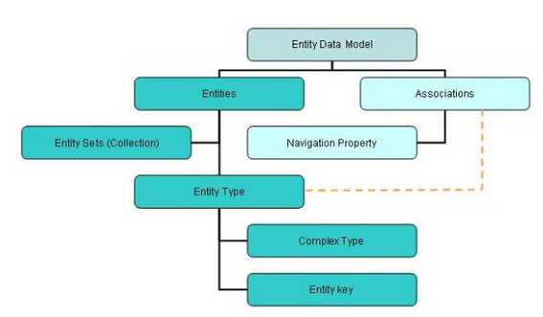
Metadata of OData
The metadata of OData message can be summarized as follows.
Refer to this blog: http://www.odata.org/

Slide 23
Definitions
An Entity type can be considered as data type that contains details of specific type of data.
For example: Customer, Supplier, Sales Order, Employee etc.
An Entity set is nothing but a collection of Entity type.
Entity Key is used to uniquely identify an Entity Type.
For example: Employee number , Sales Order number
Association is simply relation ship between two or more Entity types
For example: Products to its Manufacturer
An entity set Product can be associated with an entity set Manufacturer in an OData metadata.
Navigation Property is a property set on an entity type to understand the associations of the entity type.

Slide 24
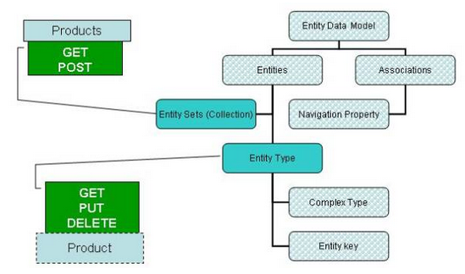
Possibility operations
We can do a GET and POST request on an Entity Set while GET, PUT and DELETE can be done on an Entity.

Slide 25
Service Operations
Service Operations:
- GetEntity
we can refer to as work area in ABAP
- GetEntitySet
we can refer to as internal table in ABAP
- Create
We can create only single record at once.
- Update
We can single only record at once.
- Delete
We can delete only single record at once.

Slide 26
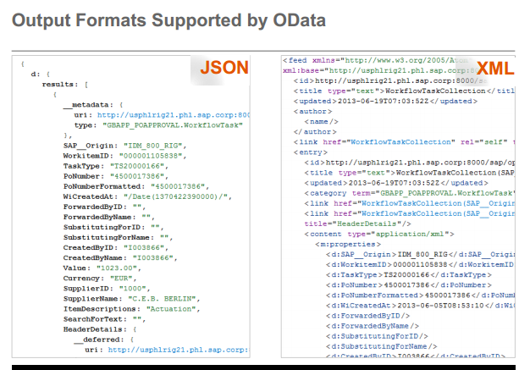
Why OData
Why OData instead of REST ?
We have seen how OData provides you with a consistent uniform standard way of describing the data and the data model. That precisely gives it an edge over REST.

Slide 27
Prerequisites check in Gateway system
Check whether SAP Gateway is activated.
Check whether system alias is maintained.
Check whether Service maintenance is registered and maintain successfully.
Check, based on SP level where all SAP notes has been implemented which are recommended by SAP.
Check whether virus scan profile is deactivated or not.
Clear the cache when ever the services are regenerated.

Slide 28
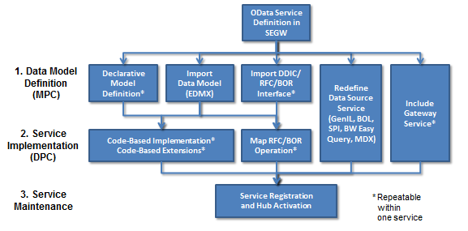
Gateway Service Builder Tool
Gateway Service Builder (transaction "SEGW") is available as of Release 2.0 Support Package 4/5 and it greatly accelerates the OData service development process. In many cases you don't even need to write a single line of ABAP code - unless of course you prefer to do so. It is no longer mandatory that you have deep ABAP OO skills.
In Service Builder we need to do follow below three steps to build an OData service:
Define or import the data model
Implement or generate the runtime logic for the service operations
Activate and run the service
The picture shows the various options
that are covered in SEGW:

Slide 29
SEGW
Need to understand below terms in SEGW transaction
- Entity Type
- Entity Set
- Association
- Navigation
- Referential Constraints
- MPC( Model Provider Class )
- DPC( Data Provider Class )

Slide 30
Questions and Answers
Is JSON supported?
Yes, JSON is supported for all the service operations, but it does not supports for metadata.
Components which needs to be installed in Embedded Architecture?
If it is SAP Net weaver 7.0,7.01,7.02,7.03 below components should be installed
IW_BEP, GW_CORE, IW_FND.
If it is SAP Net weaver 7.40 or higher, SAP provides default SAP_GWFND.
How to clear cache?
In Gateway HUB - /IWFND/CACHE_CLEANUP
In Backend - /IWBEP/CACHE_CLEANUP
You can deactivate caching from
SPRO -->Gateway -->OData Channel -->Administration -->Cache Setting -> Metadata . Also you will find some more options for Cache here
How to activate/deactivate virus scan profiles?
/IWFND/VIRUS_SCAN
Maintain System alias
SPRO->SAP Netweaver ->Gateway Service Enablement->Connection settings to SAP Netweaver Gateway->SAP Netweaver Gateway Settings.
SPRO->SAP Netweaver ->OData Channel->Connection settings->SAP Netweaver Gateway to SAP system->Manage system alias.

